Slide 1


Slide 2


Slide 3


Slide 4
Agenda
Agenda
Vision
Demo
Management
Architecture
Notes:
Vision - Anekdote
Intro, Agenda, Demo – 6 Minuten
Management Stuff – 6 Minuten
Architecture – 6 Minuten

Slide 5
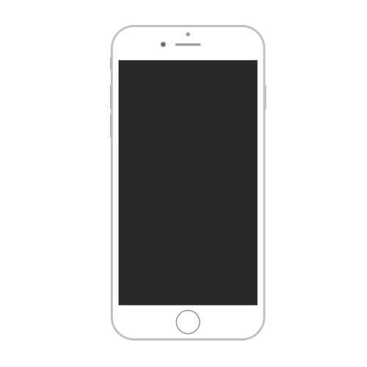
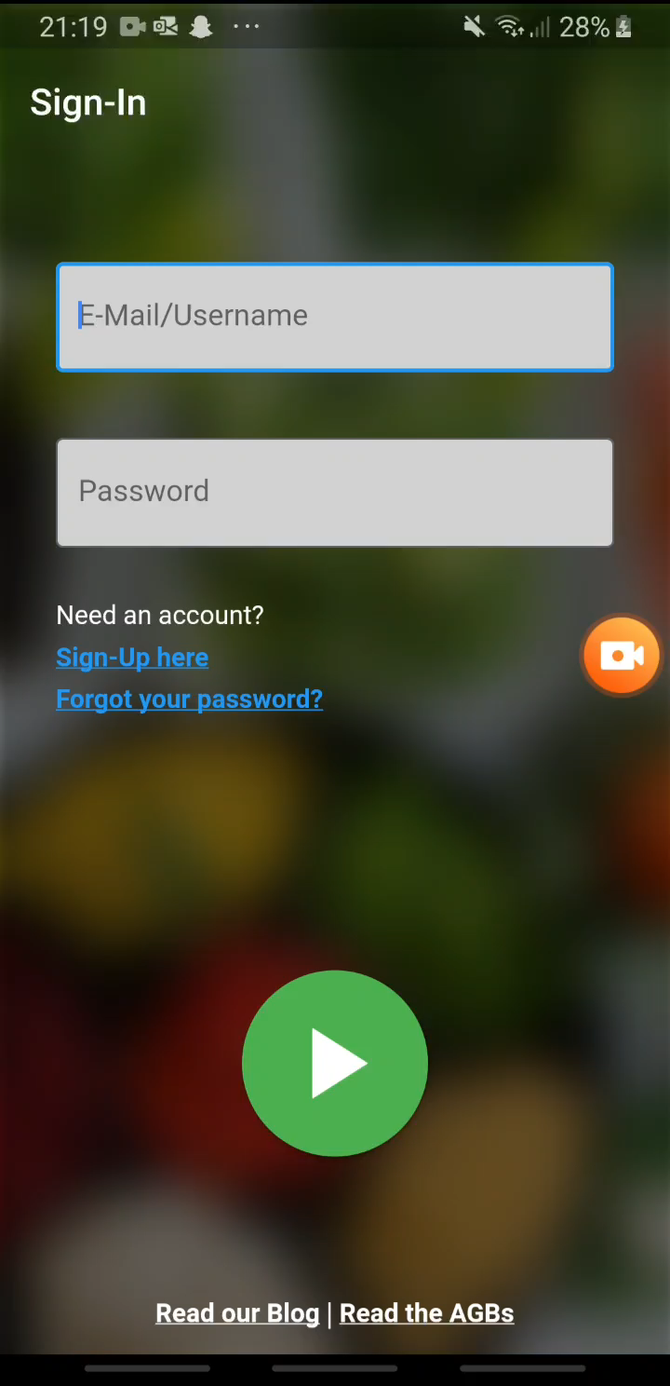
Demo

Slide 6
Management

Slide 7
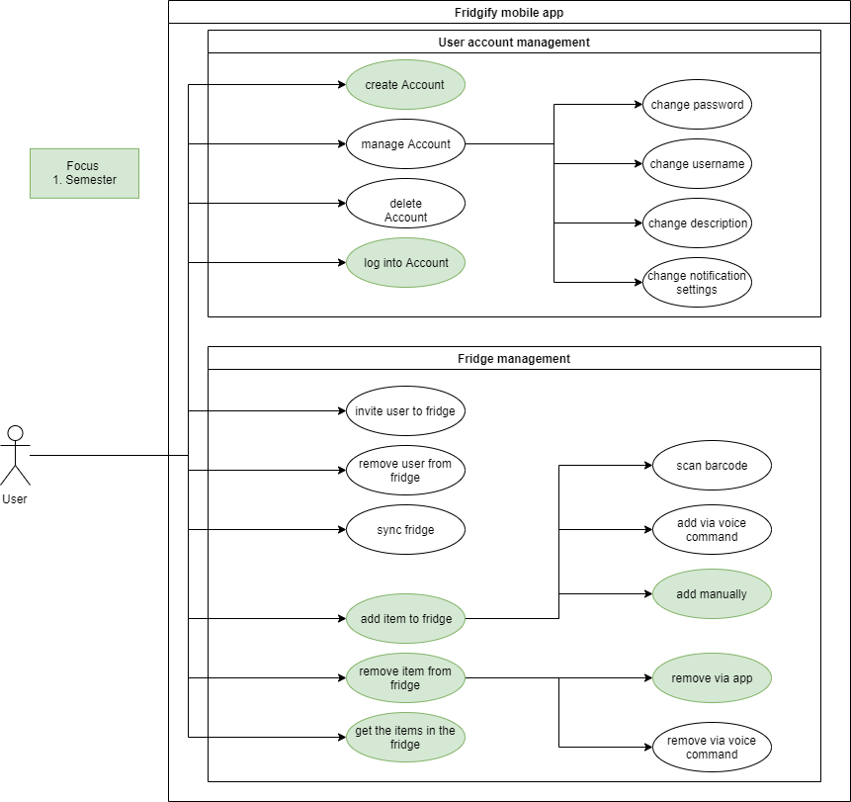
Use Cases

Slide 10
Use Cases

Slide 11
RUP Roles | Long Term Planning
Dennis Rein
Project Manager
Business Designer, Requirement Specifier, Designer, CCM
Joschua Götz
Scrum Master, Deployment Manager
Business Designer, Requirement Specifier, Designer, CCM
Duc Vo Ngoc
Tool Specialist, Configuration Manager
Business Designer, Requirement Specifier, Designer, CCM
Notes:
Project Manager -

Slide 12




Project Management – Why?
Important Aspects
Notes:
Quality, Clear Tasks/Features, Focus on important tasks, Time Management (fair task distribution, in time)

Slide 13
Project Management – What?
Fast and Efficient
Adaptability
Scrum
Effective Usage
Feedback
Large -> Small
Easy to observe
Notes:
Quality, Clear Tasks/Features, Focus on important tasks, Time Management (fair task distribution, in time)

Slide 14


Project Management – How?
Scrum
Sprint
(1 Week)
Product Backlog
Sprint Backlog
Product Increment
Notes:
Quality, Clear Tasks/Features, Focus on important tasks, Time Management (fair task distribution, in time)

Slide 15
Scrumming on YouTrack
Advantages
Easy Issue
Tracking
Integration for IDE
Reports for
PM
Sprint Boards
Simple Time Tracking

Slide 16


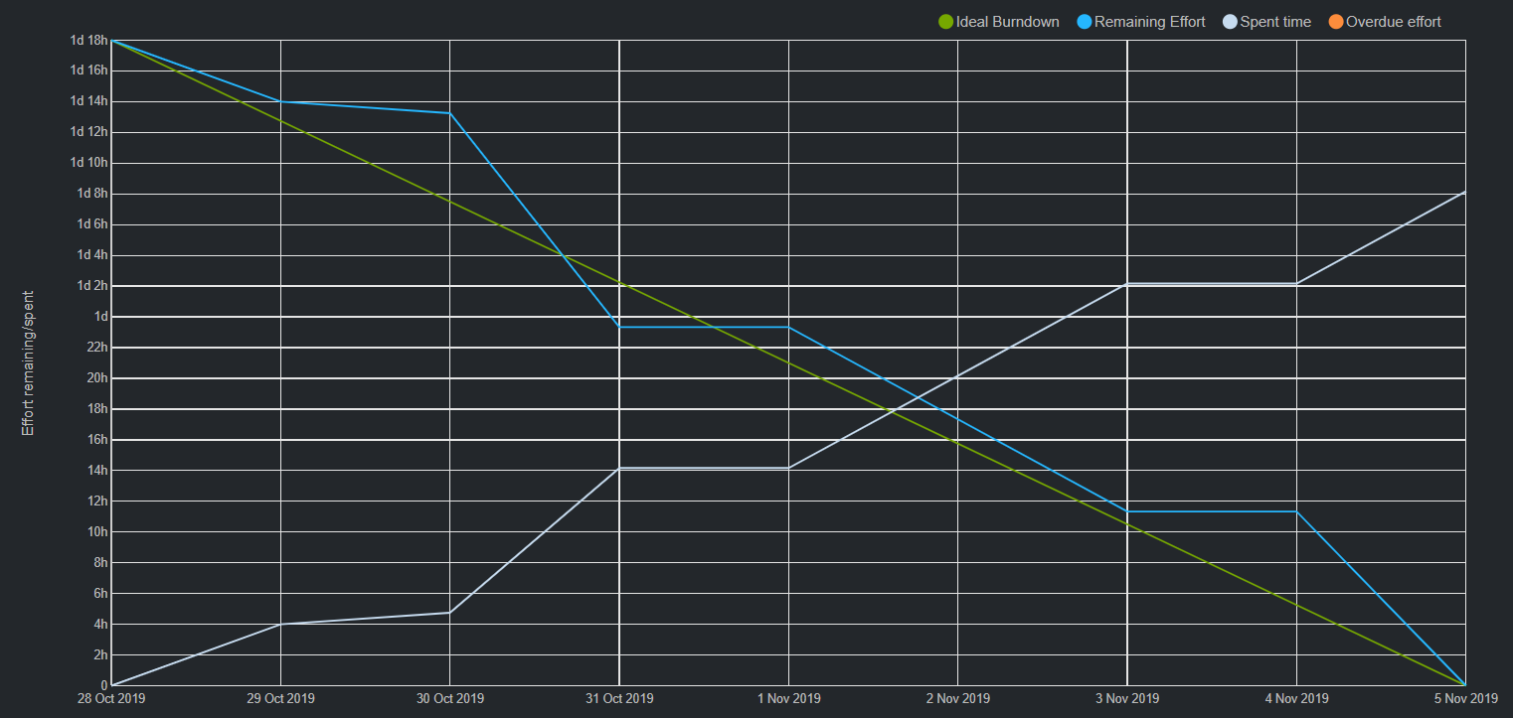
Scrumming on YouTrack
Sprints
1 Week
Reports

Slide 18
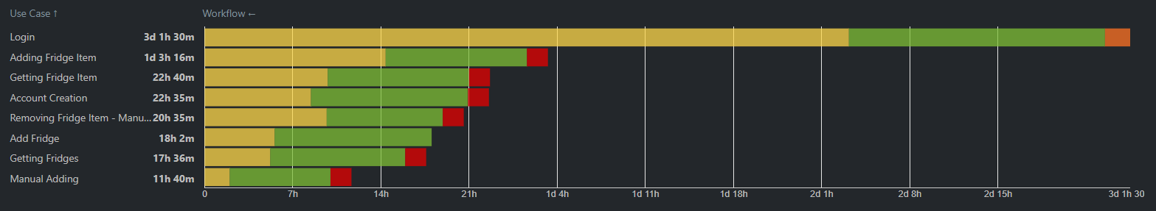
Scrumming on YouTrack
Sprints
1 Week
Reports

Slide 20
Quality
Assurance
User
Tests
Security Testing
Integration Testing
Unit Testing
Code Reviews

Slide 21
Architecture

Slide 22




Repositories fridgify
Documentation / Releases
Github
Fridgify
Frontend development
Backend development
Fridgify Frontend
Fridgify Backend
Docker
Docker image management
Fridgify

Slide 23
Automated testing backend
Documentation / Releases
Github
Fridgify
Frontend development
Backend development
Fridgify Frontend
Fridgify Backend
Docker
Push to
On Docker Hub
Docker image management
Fridgify
Runs tests automatically based on built image
Feature branch
Publish
Builds image
Tests fail ?
Report failure
No
Yes

Slide 24
Server enviroment – Development stages
Server – Serverprovider
Released versions
Completed features
Production – fridgapi.donkz.dev
Testing – fridgapi-dev.donkz.dev
Development of
new features
Development – localhost

Slide 25

Continuous Distribution – Continuous Integration
Released versions
Production – fridgapi.donkz.dev
Completed features
Production – fridgapi-dev.donkz.dev
Create / Update
Create / Update
Run gherkin tests
Build production job
Build production job
Listen to commits to feature branches
Report outcome
Listen to new releases on master
Listen to commits to the develop branch
Github
Frontend development
Documentation / Releases
Fridgify Frontend
Fridgify
Backend development
Fridgify Backend

